Slide 1
Group 1
Aaron K Benjamin A,
George F Joe W

Slide 2
Logline
2D puzzle platformer where the player must follow another survivor while avoiding the perils of a hostile environment by solving puzzles.

Slide 3
Target Audience
18-25 year old
Casual

Slide 4
Emotions
Chrysalism: The amniotic tranquility of being indoors during a thunderstorm.
Adronitis: Frustration with how long it takes to get to know someone.

Slide 5
Chrysalism
Form of Protection
Safe shelters
Players make the shelters safe
Fiero
Contrasts the harshness of a thunderstorm
Hostile environment
Overcoming Challenges

Slide 6
Adronitis
Encounters a mysterious figure
Unable to approach
Gain Knowledge of this person through collectibles
Exploration
Curiosity

Slide 7
Mechanics
Platformer
Jumping
Player Movement
Item Collection
Enemies
Non violent approach to dealing with levels
No weapons
Using puzzles to dispatch enemies

Slide 8
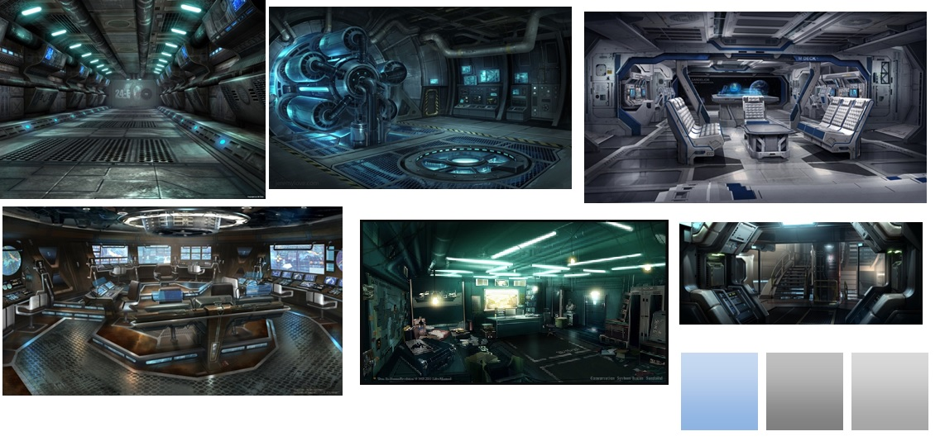
Interior

Slide 9
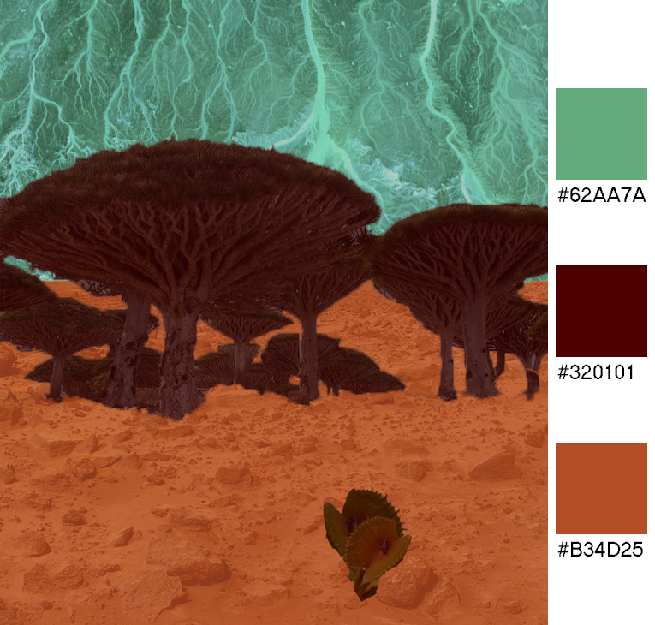
Outer Environment

Slide 10
What next?
Rough prototype containing the core triggers
Visual, Art Assets, Concepts and Final Designs
Puzzle Mechanics
Balance difficulty with our target audience
Playtesting
Iterating

Slide 11
Questions?

